Slide 1




Empower Educators:
Master Classroom Management with Proven Solutions
Dr. Tracey Roden
RethinkEd, VP of Product
Erin Hornbeck
RethinkEd, Director of Product and Integrations
2022 Overview

Slide 2



Grounding & Check-In
1. Frustrated
2. Anxious
3. Neutral
4. Calm/ Relieved
5. Happy/ Excited
Notes:
How are you feeling overall today?
How are you feeling about talking about behavior?
I’m going to share what seems like a lot of information today. I want you to think about the themes that emerge as we go through the 4 components of behavior.
What do you already do well? What would you like to learn more about? What do you have control over?

Slide 3
Comfort Level Check
1
2
3
4
Newbie
Learning
Independent
Confident
Notes:
TRACEY:
Before we dive into the support we need to manage behavior in our buildings, I wanted to “check-in” to gain an idea of everyone’s confidence levels.
How do you feel about your knowledge level regarding behavior management systems and practices in the school and classroom?
Take a moment to reflect and identify which number 1, 2, 3 or 4 best describes where you fall on this confidence scale.
You can place your response in the chat to let me know.​
Brand new to this topic and ready to learn and get support!
I’m still learning and would benefit from more information and resources to help me support my staff and/or students.
I’m getting there and feel good about continuing to expand my resources and support system. ​
I’m confident and ready to move forward and organize myself for success using a dependable system!

Slide 4
Objectives
Understand what systems and practices are needed to
  Make classrooms more conducive to learning
  Prioritize implementation resources to support staff and systems
  Have a strengths-based approach to supporting students
Notes:
TRACEY:
Disruptive classroom behavior is rising, and student engagement is at an all-time low. With limited resources, teacher shortages, and widespread burnout, school districts are facing enormous challenges.
We will examine proactive approaches to empower educators to manage their instructional environments by focusing on the key elements of management systems to maximize both student and educator success.
Objectives:
Understand what systems and practices are needed to produce those student outcomes we all desire in our classrooms.
Read 3 bullets.
Make classrooms more conducive to learning
Prioritize implementation resources to support staff and systems
Have a strengths-based approach to supporting students
The regularity or the systematic way our districts function to support educators with behaviors is going to assist the development of those desired outcomes we want in our classrooms.
As we work through this webinar, we will begin to see how educators and students benefit from these systems and practices.

Slide 5
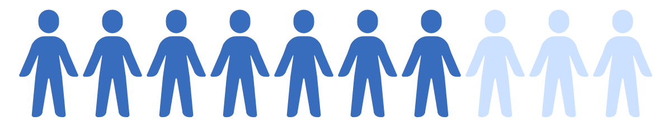

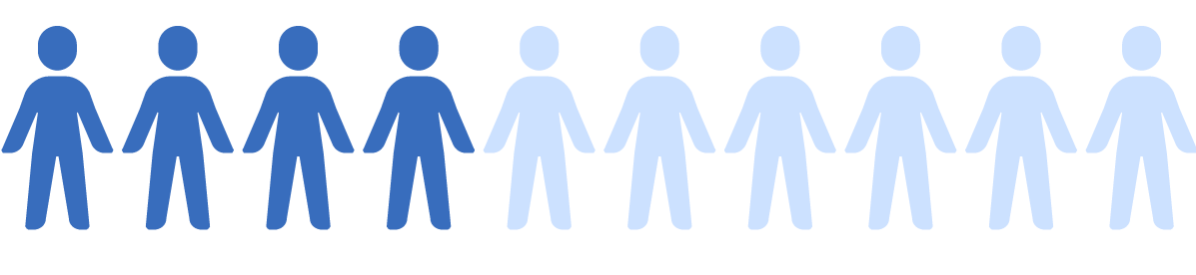
Disruptive student behavior is on the rise…
More than 70% of teachers report a recent increase in disruptive behavior in the classroom.
87% of schools reporting increased incidents of misconduct, rowdiness, disrespect toward staff and peers, and prohibited use of electronic devices
More than 40% of teachers think that they are not fully prepared for classroom management and handling student behavior.
Notes:
TRACEY:
What we know………
The problem –
Increase in challenging behaviors
Decrease in instructional time trying to manage behaviors
Decreased teacher and student morale
Read the bullets on slide

Slide 6
Poll Question 1: What are the biggest challenges your district faces in managing student behavior?
1 - Limited training for staff​
2 - Inconsistent behavior management strategies​
3 - Lack of resources to address behavior issues​
4 - High levels of disruptive behavior in classrooms​
5 - All of the above​
Notes:
TRACEY:
Live chat – Poll 1 question:
Limited training for staff
Inconsistent behavior management strategies
Lack of resources to address behavior issues
High levels of disruptive behavior in classrooms
All of the above
We cannot separate behavior from the classroom.
We have to be able to replace undesirable behaviors with another behavior skill.
We do this by having a strong system and practices in place to implement strategies and interventions to address those behaviors and their root causes.
WHAT ARE SYSTEMS AND PRACTICES?
Systems - Support staff behavior. It is the way your school operates to support successful behavior management. EXAMPLES BELOW
Year long continuous professional development plans
Centralized location to collect and review behavior data
Leadership teams at the building level to support behavior management
Practices – Support student behavior. These are the strategies and interventions backed by research and evidenced-based to support ALL student. EXAMPLES BELOW
Continuum of procedures to discourage behaviors that interfere with instruction
Classroom management practices
Behavior skill curriculums, Tier 2 and Tier 3 targeted supports and interventions embedded within problem solving teams.

Slide 7
Unsustainable......
Teacher training gaps
Multiple platforms and processes
Inefficient intervention and planning processes
Limited tracking tools
Notes:
TRACEY:
If we lack that system that supports adults and we lack those practices that support students, we end up with an unstable environment, one that cannot maintain it's current level of instructional delivery and learning.
Here are a few things that lead to an unsustainable environment (Read slide).
What we need is that system and those practices that help educators develop the knowledge and skills they need to address students behavior challenges.

Slide 8
Instructional Behavior Management PD, Interventions and Tools Outcomes:
Build capacity for understanding & addressing behavior
Increase positive & safe classroom environments
Increase instructional time & academic achievement
Decrease behaviors (reduce ISS, OSS, and expulsions)
Decrease disproportionality & over-referrals
Promote transparent & defensible documentation
Facilitate data-driven decisions & real-time interventions
Foster equitable practices in behavior management
Provide “now what?” tools
Notes:
TRACEY:
What happens when we replace training gaps, inefficient systems, processes, and limited tracking tools with strong instructional behavior management?
What is Instructional Behavior Management?
A system and practices that support effective instruction.
Thoughtful planning followed by careful implementation
Centralized Data insights
Established leadership team that prioritizes professional development and behavior supports
Behavior support tools that meet the needs of ALL our educators and students
Structured centralized supports for
Active learning and application opportunities
Accessible training and tools to implement instructional behavior management
OUTCOMES - READ SLIDE:
Some of the outcomes of instructional behavior management:
Students are engaged and feel connected to their school and peers
Teachers get more time on instruction instead of behavior management
Read some slide item bullet points

Slide 9
Provide Educators with the high-quality behavior PD, interventions, tools and systems to implement behavior management in their buildings and classrooms successfully
Notes:
TRACEY:
We need to provide educators with a comprehensive solution – something that includes all the elements needed to get the job done.
Ongoing professional development that promotes these outcomes:
Educators to refine their behavioral instruction
Administrators to refine their leadership skills
Resources and step-by-step guidance on designing that instructional behavior management environment.
Housed existing strategies and interventions easily accessible to educators

Slide 10
Poll Question 2: What challenges do you anticipate in implementing instructional behavior strategies??
1 – Lack of time and resources
2 - Resistance from staff
3 - Need for more training and support
4 – Difficulty in measuring effectiveness
5 – Lack of the right strategies and interventions
6 - All of the above​
Notes:
TRACEY:
Live chat – Poll 6 question:
1 – Lack of time and resources
2 - Resistance from staff
3 - Need for more training and support
4 – Difficulty in measuring effectiveness
5 – Lack of the right strategies and interventnios
6 – All of the above

Slide 11
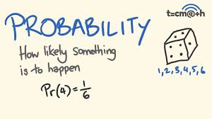
What is the PROBABILITY of behavior management working?
Some things work better than others.
What “THINGS” should an educator do to maximize the probability of a student’s success with behaviors?
Do these “THINGS” to set students up to be successful with instruction
Notes:
ERIN:
Dr. Terry Scott is a professor and distinguished University Scholar at the Center for Instructional and Behavioral Research in Schools at the University of Louisville.
Dr. Scott studies and talks about classroom management and effective instruction through strategies and interventions.
Probability:
Some THINGS work better than others.
What THINGS should an educator do to maximize the likelihood of a student’s instructional engagement success through behavior management?
Do these THINGS to set a student up to be successful with instruction and engagement.
THINGS that guarantee probability:
Understand Behavior –Understand various developmental stages of our students and the impact of trauma, mental health, and biases on our students.
Create a positive learning environment - Through PBIS, trauma-sensitive schools and classrooms
Teach students behavior skills through varying levels of support, Tier 1-Tier 3 strategies, and interventions. When we say tiers we are speaking to the type of support we are giving a student. I have a bank of Tier 2 supports I can choose from, I have a bank of Tier 3 supports I can choose from and I don't have to stand alone do carry these out, I have a support system I can rely on.
Manage Behavior (this includes having insights into behavior data and providing varying levels of support based on those data insights)

Slide 12
What are the “THINGS” you as an Educator can do to maximize the probability of a student’s success with academics through behavior management?
Notes:
ERIN:
According to Dr. Scott, about 70 years of empirical research lead us as Educators to believe there are certain things we’d like to see educators do if they want to maximize the probability of that student’s success.
I won’t get into the details of John Hatties Meta-Analysis but will briefly explain Effect Size by John Hattie. Effect Size relates to the Probability Equation.
“Which Instructional Behavior Management practice will have the highest “EFFECT SIZE" on my students in my classrooms?”.
Examples:
How are we teaching what we teach for behavior?
Teaching explicit behavior skills as in.....
Classroom physical arrangement
Routines
Feedback
Prompts and reminders
Self-management and self-regulation

Slide 13
We must engage our students.
If a student doesn’t like engaging with adults, how will we engage them?
Engagement is what creates the probability
Notes:
ERIN:
Engage: We don’t get to say, “This kid won’t engage….oh well… let’s just leave them and move on”.
Read slide
When we have strong systems and practices, we naturally lift the individual burden off of the Educator and together we keep those students engaged.

Slide 14
Highest Probability for successful Instructional Behavior.......
Understand Behavior
Create Positive Learning Environments
Teach Behavior Skills
Manage Behavior
Notes:
ERIN:
Optimizing student instructional engagement through behavioral instruction............
NEWS FLASH: Instructional interventions give us a higher probability/effect size for changing behavior than anything else we can do.
We want 80% success with Tier 1 support and what we are asking kids to do behaviorally – BY
We provide instructional practices and decisions (based on data)
Students receive the instruction and can continue managing their behavior because of those practices.
We provide evidenced and research-based interventions to the remaining 20%, and those students fluidly move back to Tier 1 supports and can manage their behaviors.
READ SLIDE
Understand Behavior –Understand various developmental stages of our students and the impact of trauma, mental health, and biases on our students.
Create a positive learning environment through PBIS, trauma-sensitive schools and classrooms
Teach behavior skills through varying levels of support. Tier 1-Tier 3 strategies and interventions. Maybe this is time management, goal setting, conflict resolution, self-regulation.....
Manage Behavior (this includes having insights into behavior data and providing varying levels of support based on student and educator needs) - setting expectations, BSF, routines, active supervision....managing behaviors through a tiered intervention system already set up and ready for delivery.

Slide 15



  A comprehensive professional development series on positive behavior management that takes a holistic and strengths-based approach to supporting students, educators, school staff, and families.
Intervention Library with easily accessible step-by-step goal banks and intervention guidance centralized in a one-stop-shop
Guided Behavior Intervention Planning including implementation resources
Intervention Effectiveness Tracking
Notes:
ERIN:
Earlier we mentioned teacher training gaps, too many inefficient platforms and processes, limited ways to track students that may be at risk and lack of reliable progress/growth monitoring.
Let’s review what a strategic long-term, multi-level plan looks like that will hit on those objectives we covered at the beginning:
Objectives:
Make classrooms more conducive to learning
Prioritize implementation resources to support staff and systems
Have a strengths-based approach to supporting students
We will look at some of the most important structures and procedures needed to create this system with those practices and interventions embedded in that system.
Read slide.....The things we need

Slide 16
Asynchronous or Synchronous
Face to Face
Observations
Coaching
Resource Banks
Communication Plans
Virtual Supports
Professional Development is a SYSTEM of support that establishes and sustains evidenced-based practices.
Notes:
ERIN:
Professional development is a system of support that establishes and sustains evidenced-based practices.
The most effective professional development engages teams of educators to focus on the needs of their students
Professional development is one of the only strategies school systems have to strengthen educator performance levels
They learn and problem solve together to ensure student success
The time we set aside for professional development far outweighs what educators may view as a scheduling inconvenience because of the educator, student and caregiver benefits received.
That SYSTEM builds capacity and sustainability ( maintain a continuous process over a long period of time, has steady continuity, and is harmonious – carried out the same way)
Asynchronous or synchronous (flexibility)
Face to Face
Observations
Coaching
Resource banks that hold all the necessary resources an educator needs to successfully manage beahvior
Communication plans
Supports that offer guidance from a team of educational professionals with tailored implementation based on the needs of the district

Slide 17
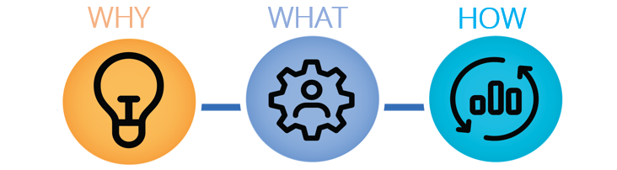
Behavior Training Series
Understand Factors
that Impact Behavior
Create Positive
Learning Environments
Teach Behavior and
Manage Behavior
Notes:
ERIN:
4 key components of behavior mentioned earlier:
Understanding factors that impact Behavior
Creating Positive Learning Environments
Teaching Behavior Skills
Managing Behavior

Slide 18

4 Key Components of Behavior
  WHY
Component 1: Understand Factors that Impact Behavior
Child Development
Adverse Experiences
Mental Health
Developmental Disabilities
Implicit Bias
Compassion Fatigue
Notes:
ERIN:
To effectively interpret student and adult behavior, we need to understand what might impact student behavior and educator behavior.
Child development
Trauma/Adverse Experience
Mental Health
Developmental Disabilities
Bullying
Educator Behavior (factors that can influence how an educator functions :STRESS)
Think, plan
Regulate emotions and manage vulnerabilities
Communicate
Compassion Fatigue
Why might students engage in behaviors that interfere with the instructional environment?
CHAT:
What are some factors that can impact student and educator behavior?
Hunger
Illness
Lack of sleep
Lack of safety
Taking care of siblings/family members
Losing their home/not having a home
Abuse
Witnessing abuse
Having to work
Mental health conditions-anxiety, depression
Racial issues (from fear to feeling dismissed to experiencing bias through interactions and educational materials)
Lack of adult support

Slide 19

4 Key Components of Behavior
  WHAT
Component 2: Create Positive Learning Environments
Safe and Caring Classrooms
Trauma-Sensitive Classrooms
Classroom Management Systems
Positive Behavior Interventions
and Supports (PBIS)
Notes:
ERIN:
The second component is Creating Positive Learning Environments .
These are the systems and practices that support safe learning environments focused on student and educator growth.
Think about Maslow’s hierarchy -safety and security is a basic need, followed by the need for interaction, connectedness and relationships.

Slide 20

4 Key Components of Behavior
  HOW
Component 3: Teaching Behavioral Skills
Self-Regulation
Stress Management
Time Management
Organization
Goal-Setting
Cooperation
Asking for Help
Respect
Conflict Resolution
Focus
Notes:
ERIN:
The third key component is Teaching Behavior Skills
Strategies to teach students to increase executive functioning, positive relationships, self-regulation and collaborative learning skills.
How do we teach students skills for learning and well-being.
We may expect students, especially in middle and high school, to have been taught these skills and perform them independently BUT....
These skills increase in complexity as students get older
Time management for a 2nd grader might mean developing time awareness and working on an assignment until the timer goes off, while time management for a 10th grader might mean learning how to plan, prioritize, schedule and manage distractions.
Going back to sustainability and continuity.
The ability to maintain a continuous process
Steady and harmonious systems of professional training, offering those same teaching skills but adaptable to those developmental stages and needs of ES vs Secondary.

Slide 21

4 Key Components of Behavior
  HOW
Component 4: Managing Behavior and the Environment
Expectations, Rules and Routines
Feedback and Reinforcement
Managing the Physical Environment
Daily Check-Ins
Engagement Strategies
Restorative Practices
Response Strategies
De-escalation Strategies
Notes:
ERIN:
The fourth key component is Managing Behavior: How do we increase the likelihood of positive behaviors occurring (Probability)?
Behavior or Classroom management includes preventive, proactive and responsive instructional practices for safe and predictable instructional environments
The list on the right looks like a lot of strategies, however you most likely have implemented many if not all just through best teaching practices.
Classroom management is not about controlling students, but rather creating an environment that supports positive academic and social behaviors.

Slide 22







Behavior Training needs to have......
Components of Effective Professional Development
Microlearning
Content-Focused
Active Learning
Structured Supports
Reflection
Collaboration
Feedback
Notes:
ERIN:
Professional development is one of the only strategies school systems have to strengthen educator performance levels
Unlike other fields, public education PD affects our students as well as our Educators.
Student learning and achievement increases when educators are engaged in effective PD that focus on skills educators need to address behavioral challenges.
PD needs to have an extensive range of learning experiences in order to be effective
Educators who do not experience effective professional Development do not improve their skills, and students suffer
PD is most effective when it occurs in the context of the educators daily work, learning is part of the school day
Components of effective PD:
Structured supports
Microlearning
Content-focused
Active –earning
Reflections
Collaboration
Feedback

Slide 23

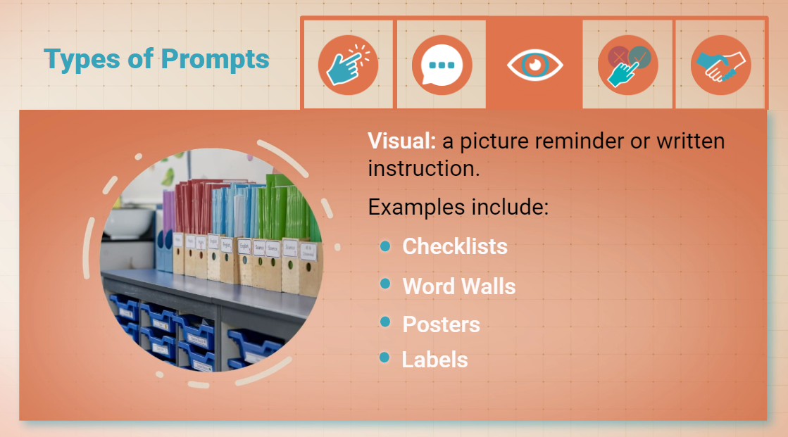
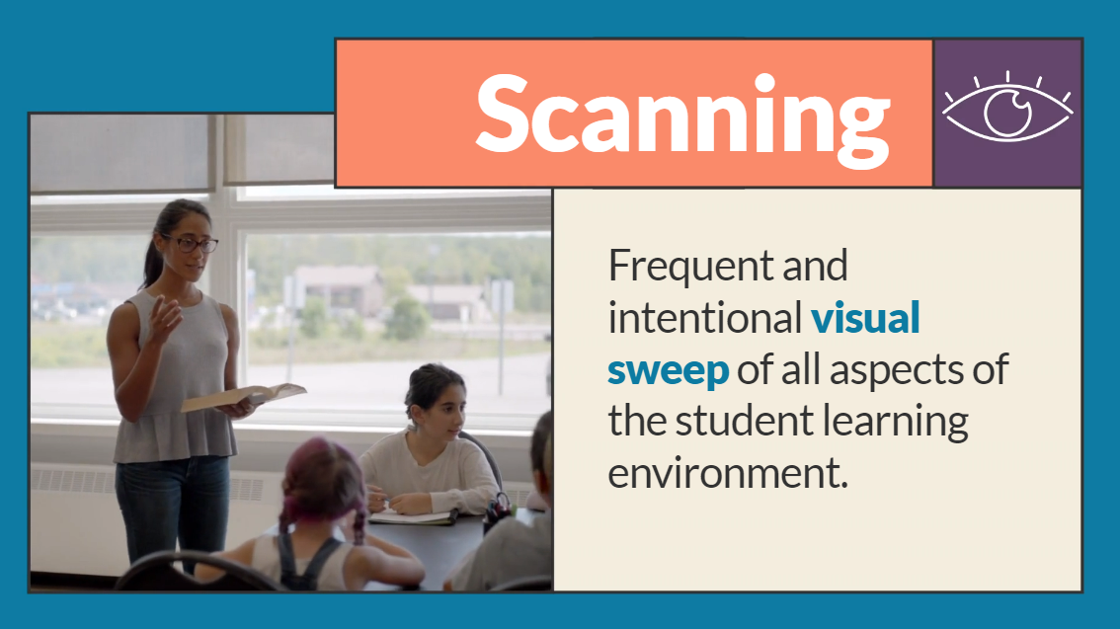

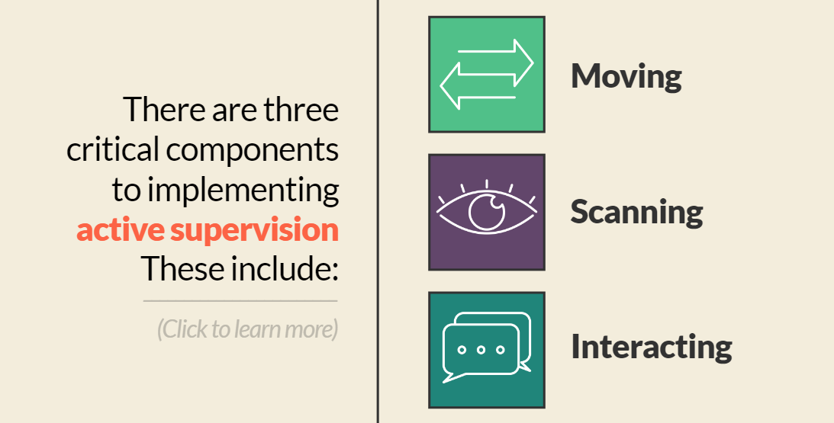
Behavior Training Series
Interactive Learning:
5 – 7 minutes each
Evidence-based
Concise and clear
Visually engaging
Interactive
Examples and non-examples
Teacher-talk
Scenarios
Notes:
A quick snap shot of what that may look like:
Interactive learning opportunities

Slide 24
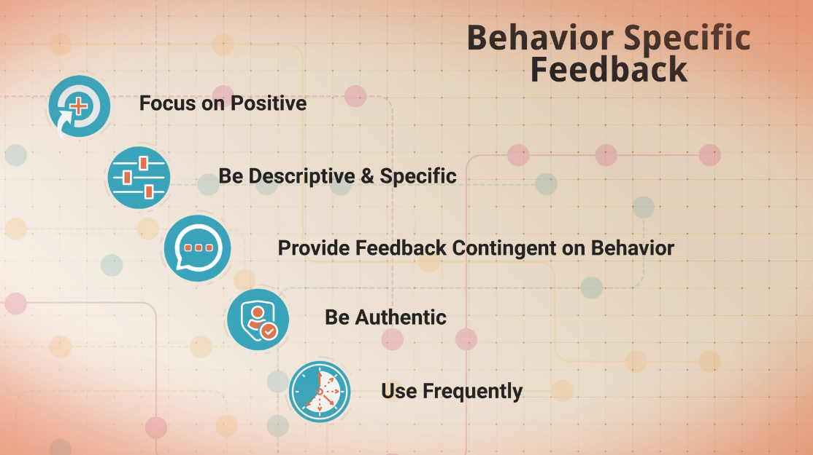
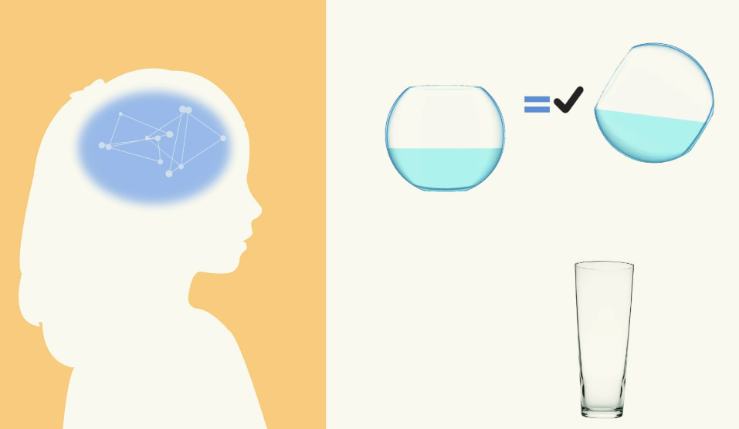
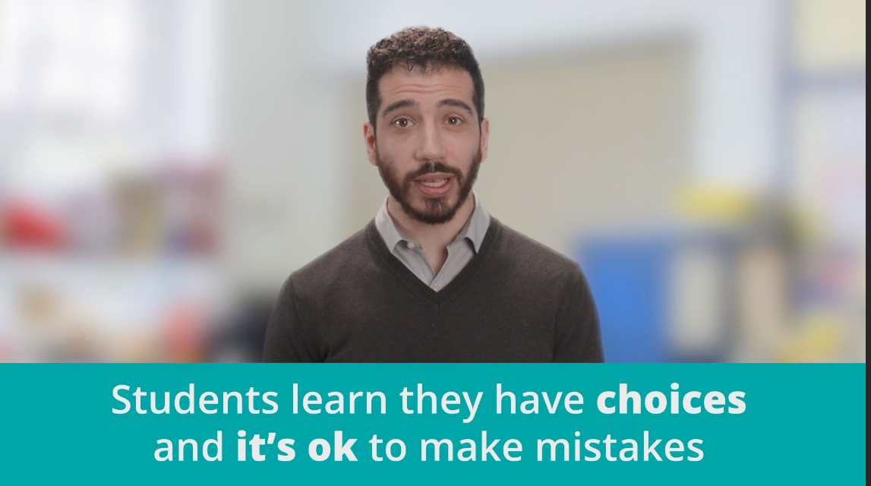

Behavior Training Series
Learn: Part 1
5 – 7 minutes each
Evidence-based
Concise and clear
Visually engaging
Interactive
Notes:
What do these components look like?

Slide 25

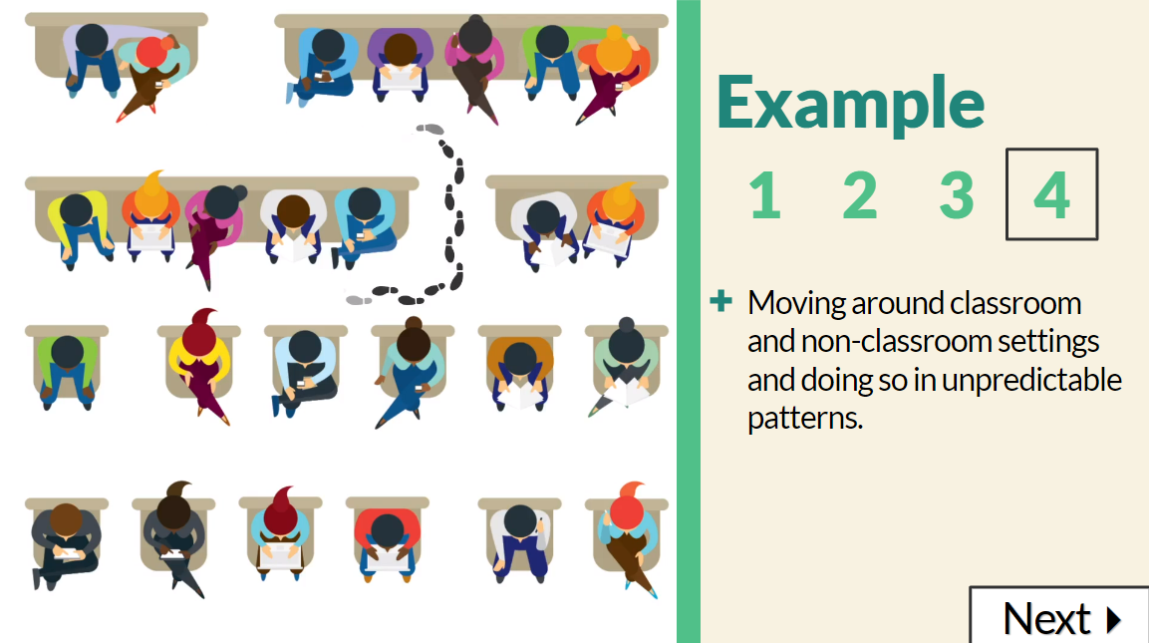

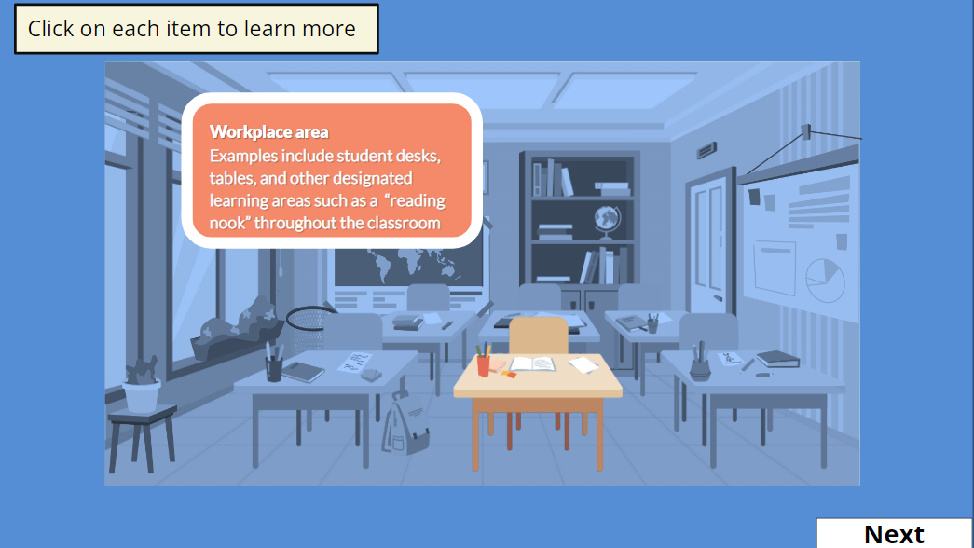
Behavior Training Series
Learn: Part 1
Examples and non-examples
Teacher-talk
Scenarios

Slide 26
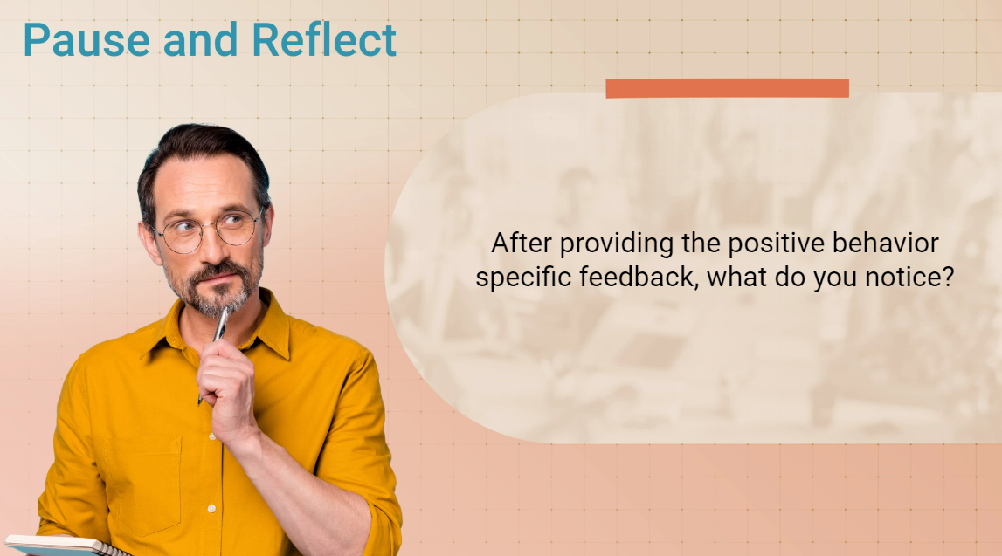
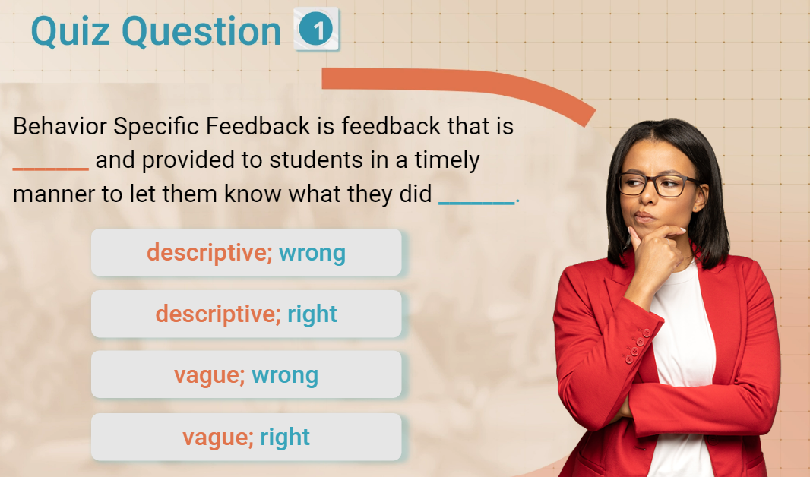
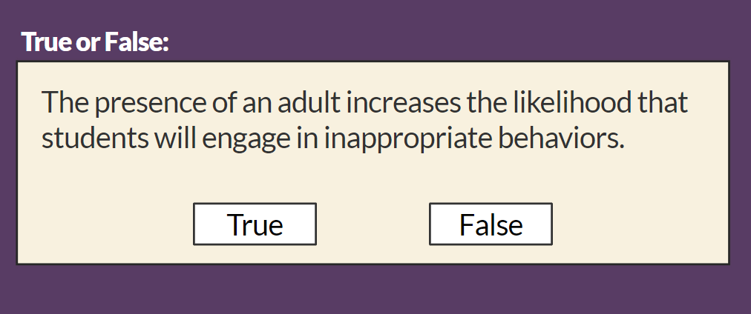
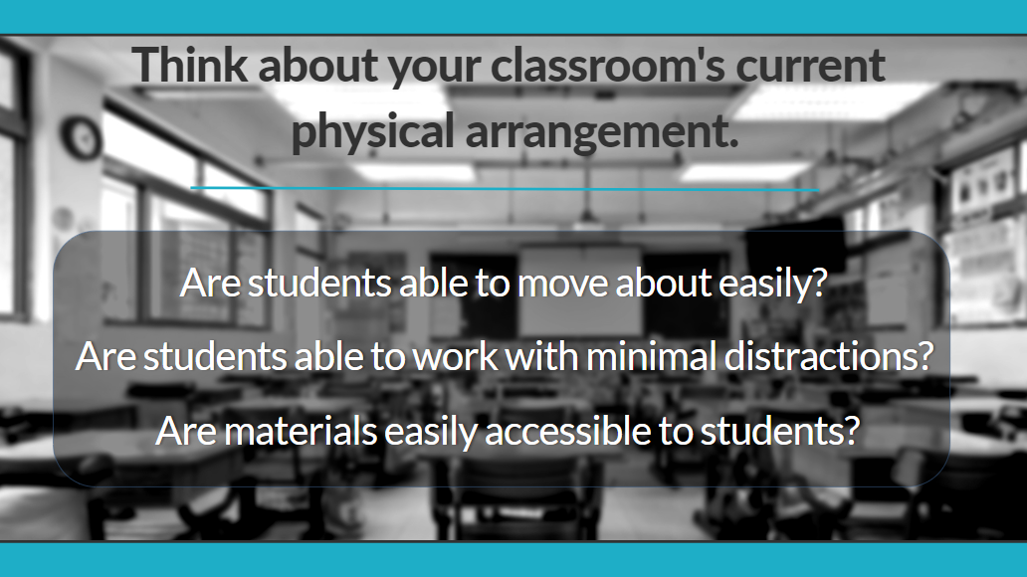
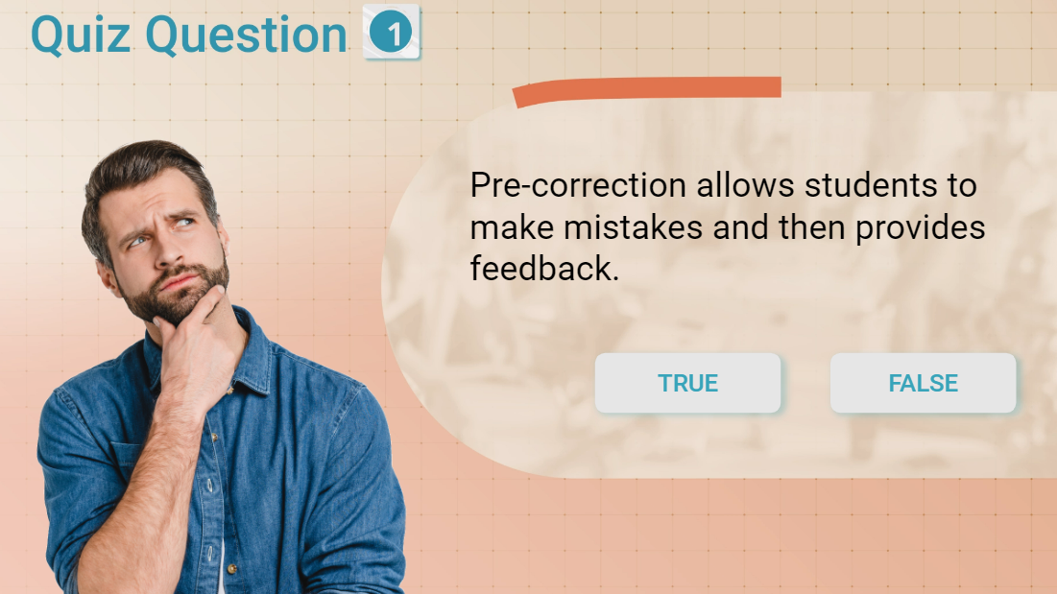
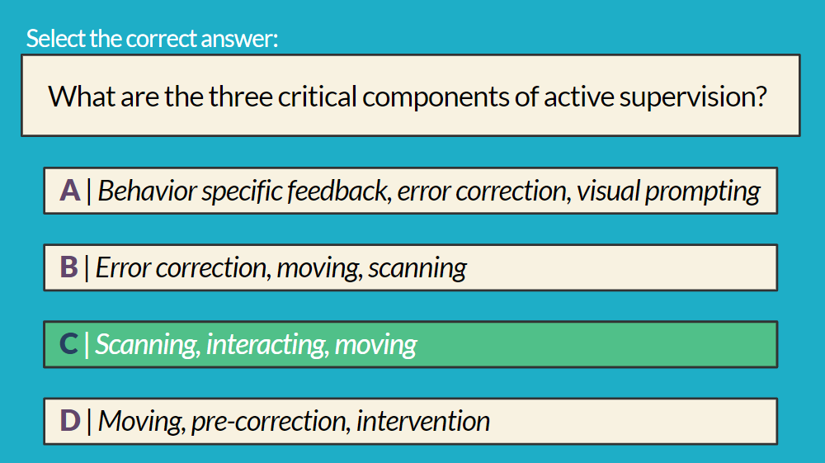
Behavior Training Series
Reflection Questions
Comprehension checks
Notes:
Interactive learning opportunities to include reflection and comprehension checks

Slide 27

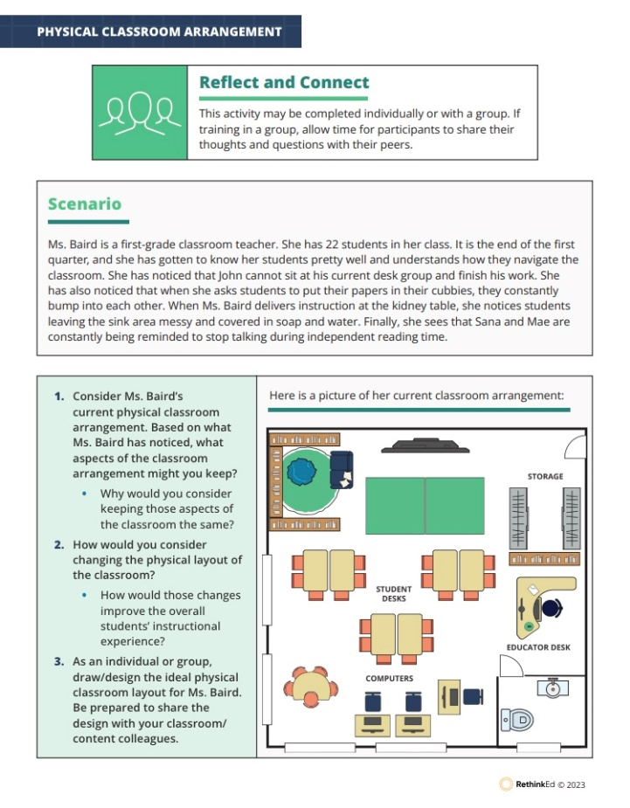
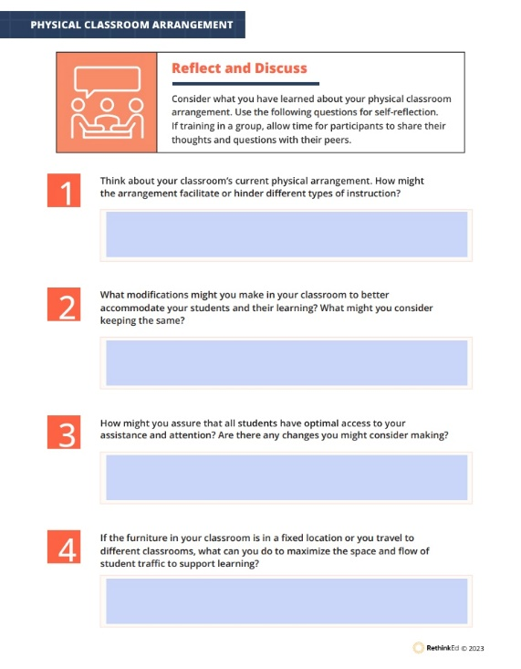
Behavior Training Series
Reflections and Goal Setting Opportunities
Goal Setting
Reflect and Connect
Reflect and Discuss
Notes:
Reflection and goal setting opportunities that include – We have an example of the physcial arrangement of a classroom.
Discussions
Connections
Goal Setting guidance to take action

Slide 28
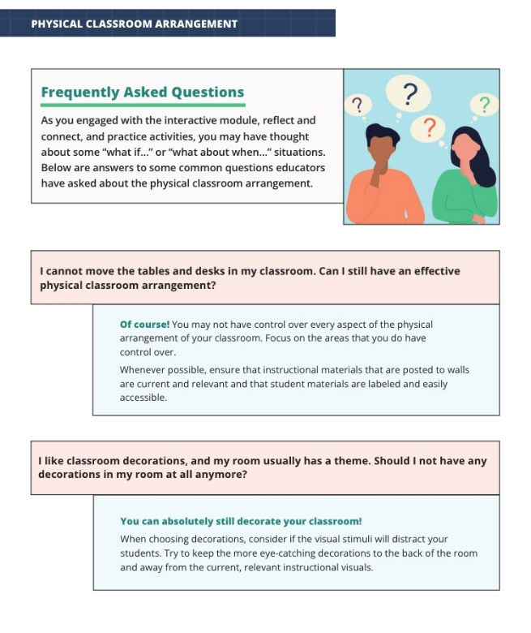
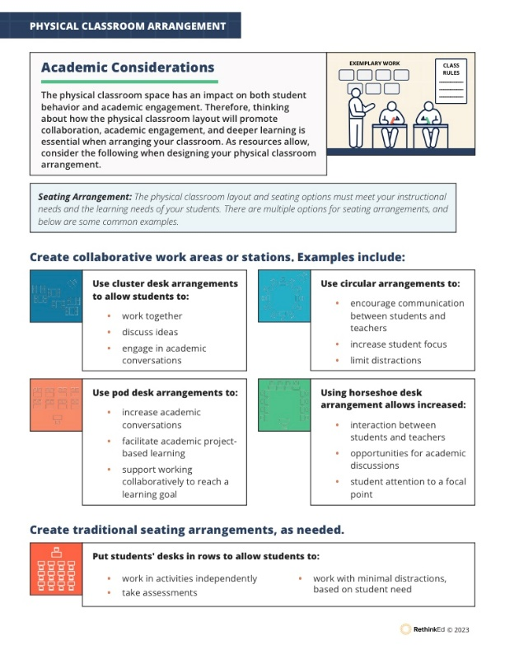
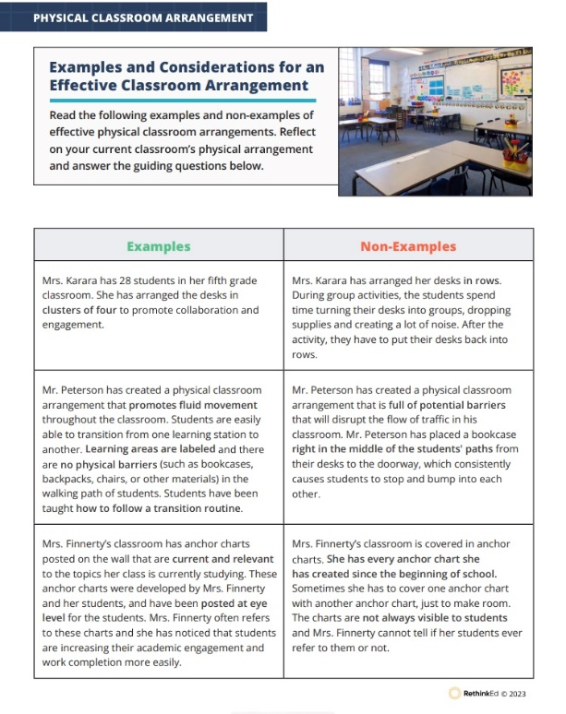
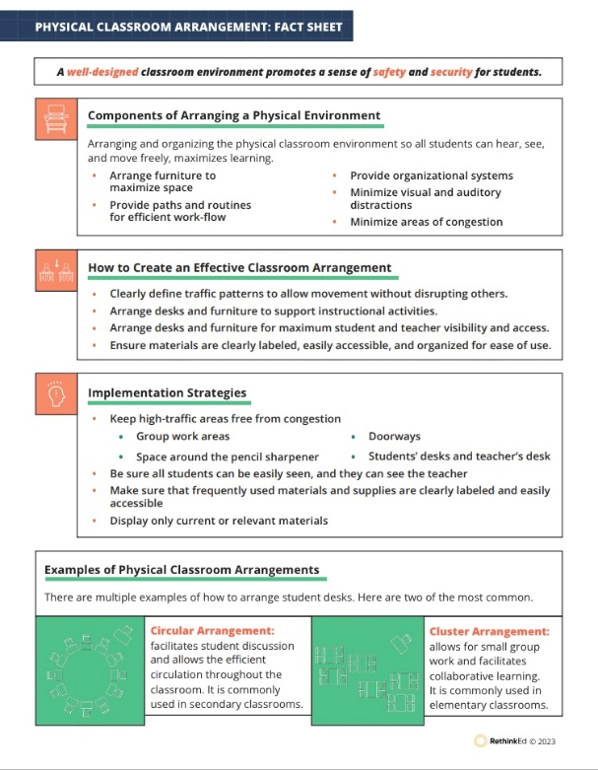
Behavior Training Series
Practice Opportunities:
FAQs
Academic Connections
Examples
Considerations
Fact Sheets
Notes:
Practice opportunities that include -
Fact sheets
Examples and non-example comparisons with considerations
Academic Considerations
FAQ's

Slide 29
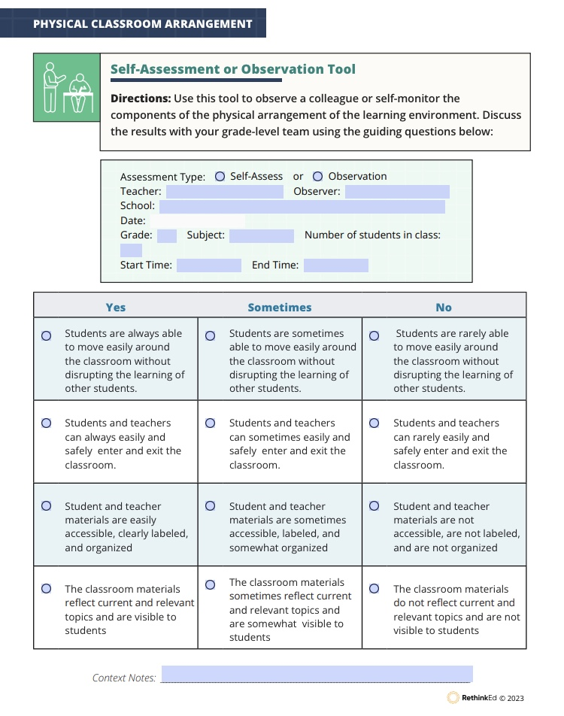
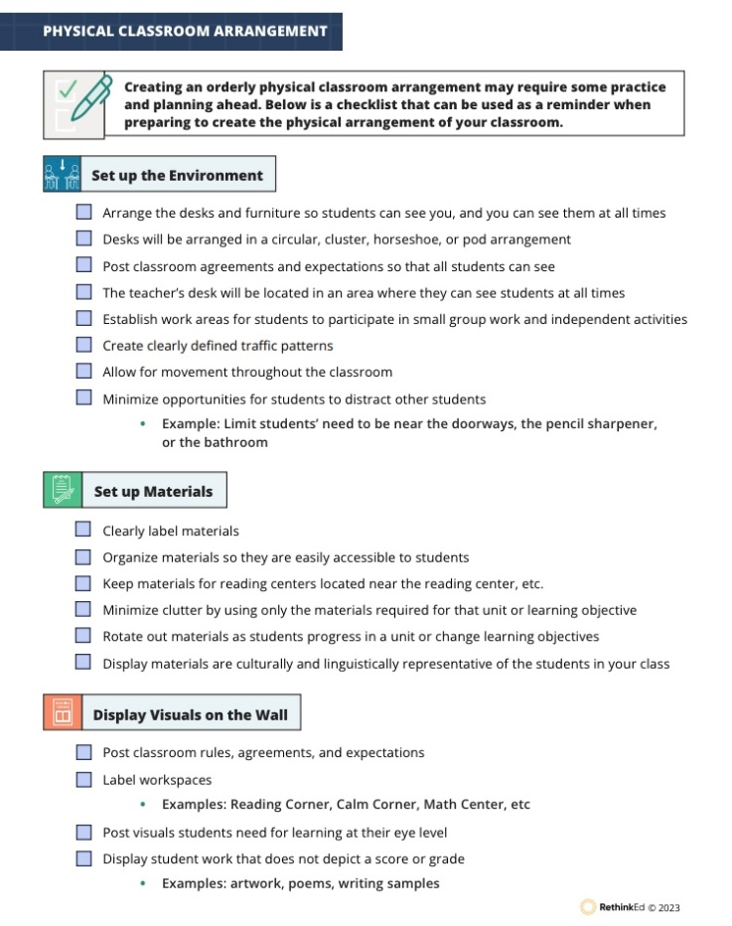
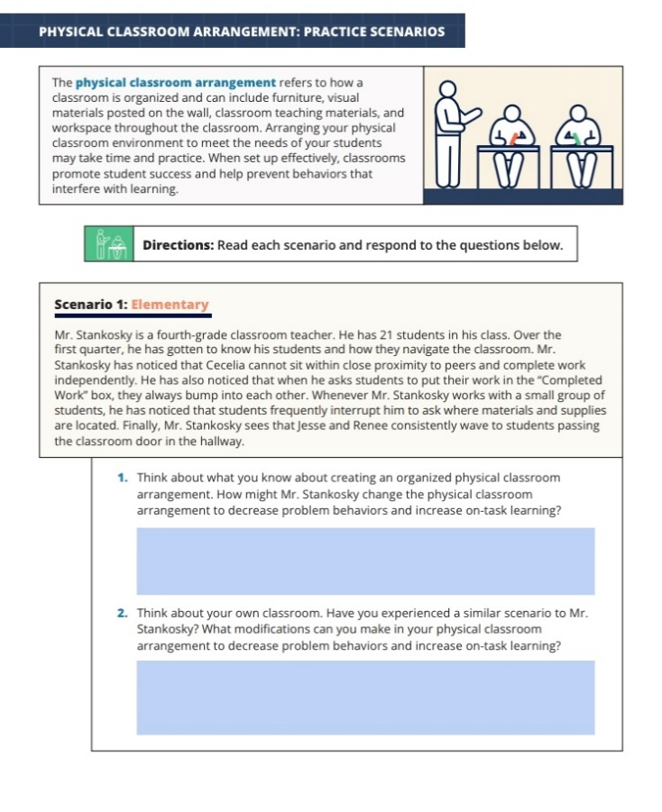
Behavior Training Series
Self-Assessment
Observation Tool
Checklists
Practice Scenarios
Notes:
Continued.....Practice opportunities
Practice scenarios
Checklists
Self-assessments
Observation tools

Slide 30


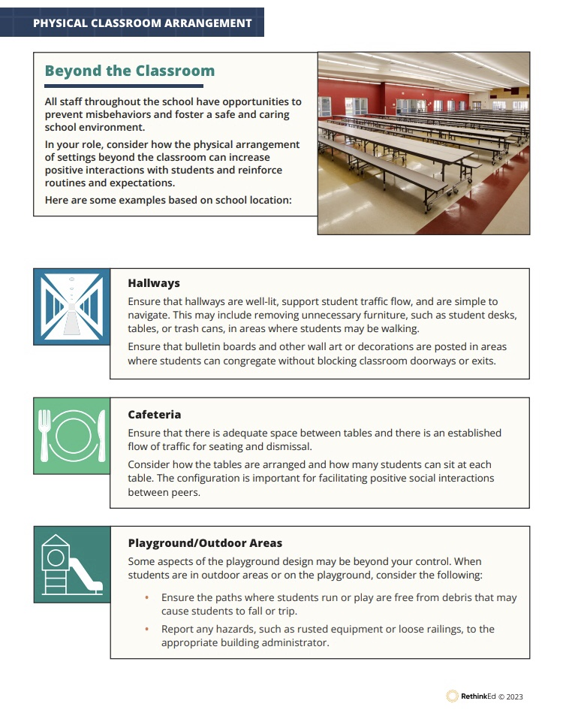
Behavior Training Series
Dive Deeper
Additional Strategies
Family and Caregiver Tips
Beyond the Classroom
Notes:
Dive Deeper opportunities:
Beyond the classroom
Family and caregiver tips
Additional strategies

Slide 31

  Analyze
Inform Data-Driven Decisions
Evaluate Areas of Need
Notes:
TRACEY:

Slide 32
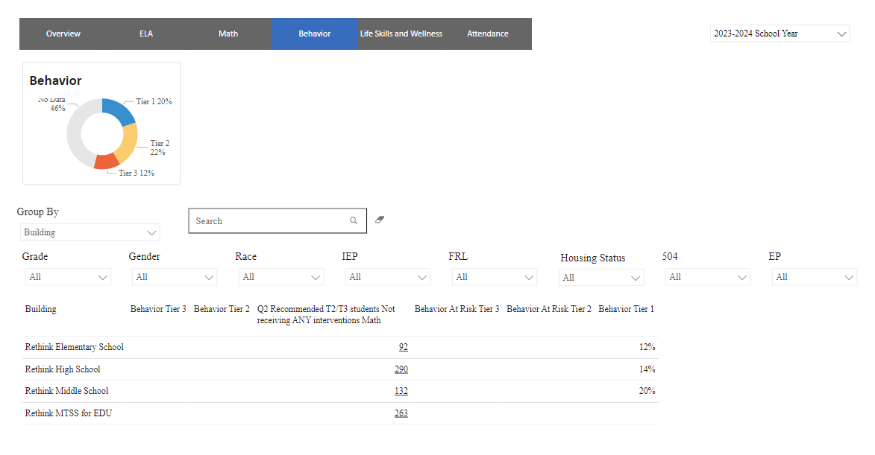
Admin Dashboards
Notes:
TRACEY:
Administrators can view the # of students at each behavior tier, based on grade and demographic information
Behavior Tiers
Can be calculated based on incidents recorded through Rethink tools or other tools used within the district
Identify students who may be in need of additional support
Ensure all plans are up to date
Data can be viewed by individual student or at the classroom, building, region or district level to effectively evaluate trends. All data can be exported directly from the platform or can be sent to the districts data housing team for custom analysis.

Slide 33
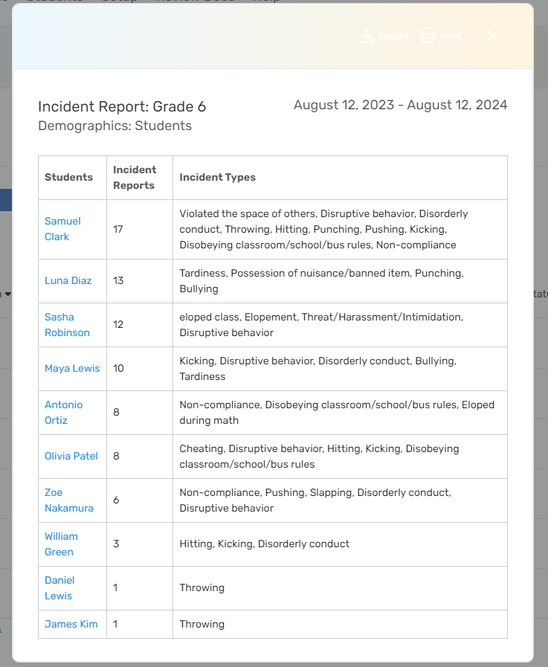
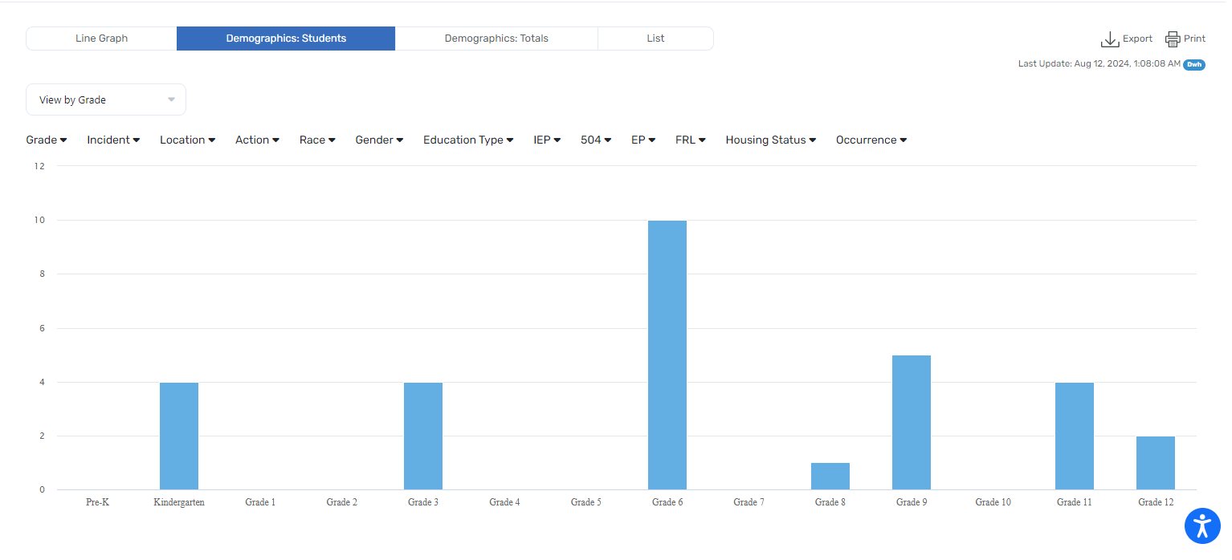
Admin Reports
Key Elements​
Record major incidents and infractions​
Include witnesses, actions taken, and any custom fields your district requires​
View formal incident report documenting the event​
Analyze trends in incidents and actions taken in relation to student demographic information
Notes:
TRACEY:
Behavior Incidents
Incidents recorded through Rethink tools or other tools used within the district
Identify trends with students who may be in need of additional support

Slide 34
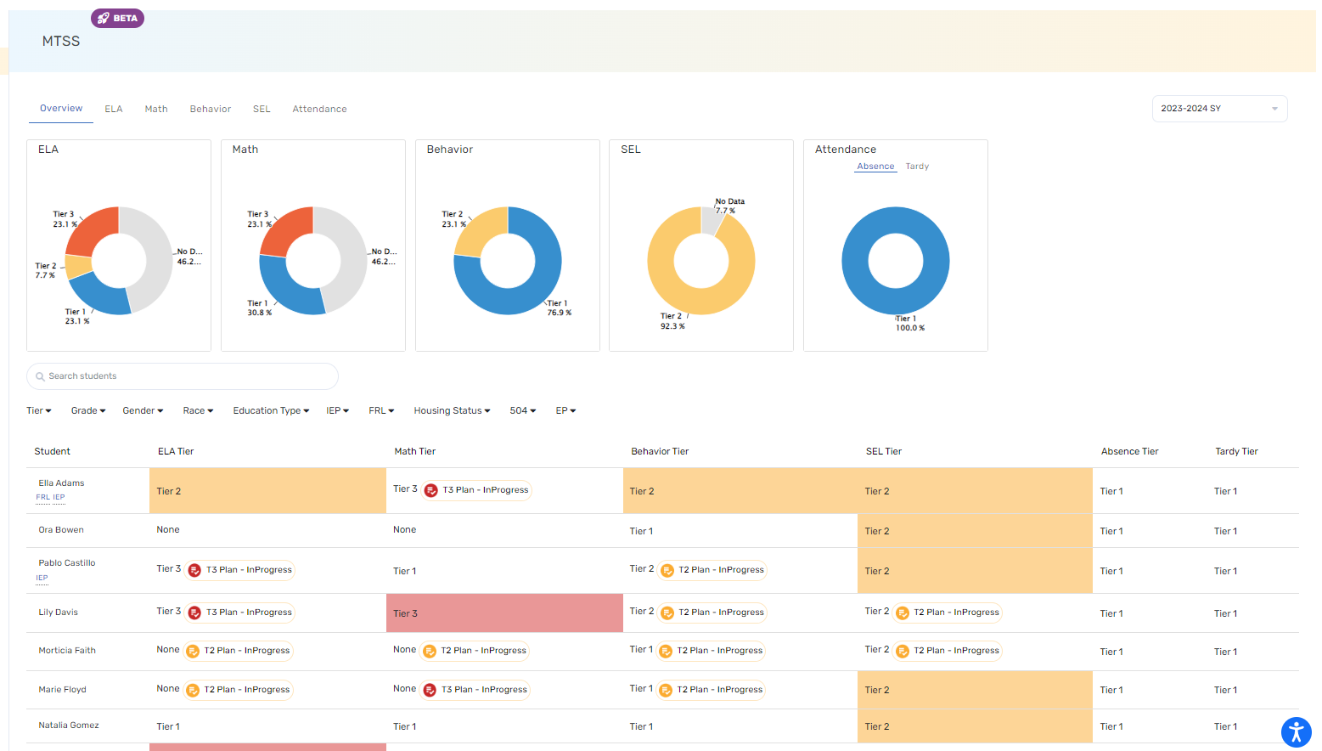
Classroom Dashboards
Key Elements​​
Visual cues for each student
Tiered notices based on recommendation
Intervention plans currently in progress with tier level and status of plan
Capability to disaggregate data by academic and demographic needs
Notes:
TRACEY:

Slide 35
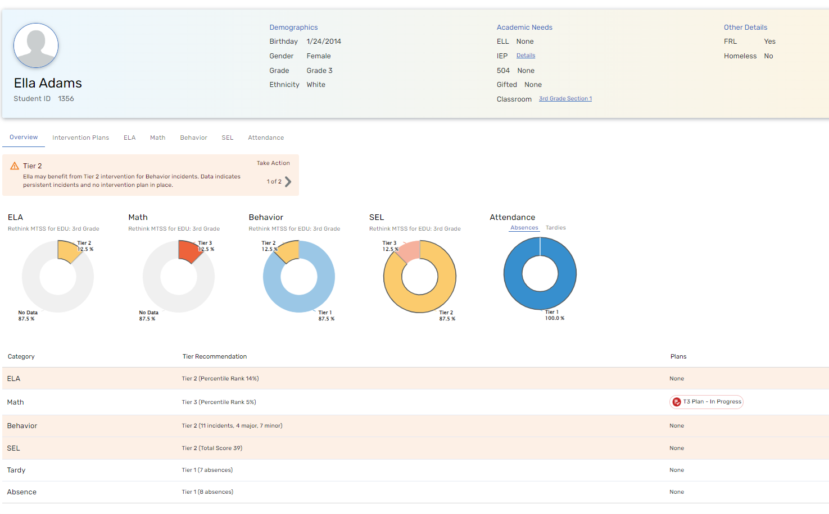
Student Dashboards
Key Elements​​​
Visual cues for each student​
Collects daily behavior occurences
Tiered notices and recommendations
Intervention plans currently in progress with tier level and status of plan​

Slide 36

  Intervene
Guided Behavior Intervention Planning
Intervention Effectiveness Tracking
Notes:
ERIN:

Slide 37

Interventions done with fidelity result in a majority of identified students responding positively.
Fidelity means the extent to which the intervention was delivered as designed
Students were systematically identified and matched to the appropriate intervention
Address common errors and barriers in Tier 2 and Tier 3 implementations
Notes:
ERIN:
Read slide then read below....
Lack of fidelity leads to
Staff frustration
Students not getting what they need
A desire to circumvent the Tier 2 process (find a way around it)
Educators need to be able to:
Analyze data
Identify problems
Develops solutions (probability)
Promptly apply those solutions

Slide 38
Comprehensive Intervention Planning Tool
Behavior Intervention strategies involve a tiered approach to addressing students' behavioral needs.
Easy step-by-step guidance for Behavior intervention plans.
​Suggested goals based on district assessment data.
Direct connection and instruction to evidence-based interventions.
Notes:
ERIN:
Comprehensive intervention plans and tools offer the fidelity needed in schools because......
A housing system of evidenced and research-based practices/interventions
Housing system = Implemented in a similar manner across students with standard procedures, standard data collection
Seamless and centralized
Familiar to all staff
Tiered approaches based on need
Quick and easy step by step guidance

Slide 39
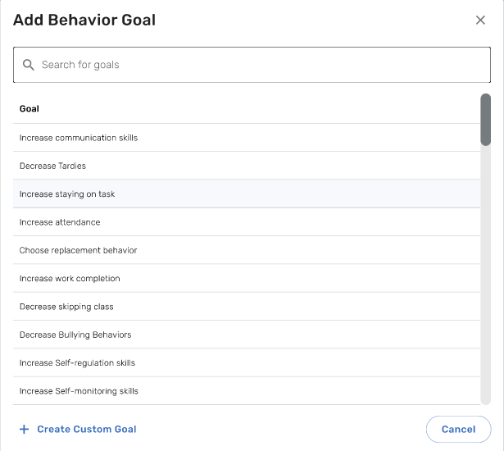
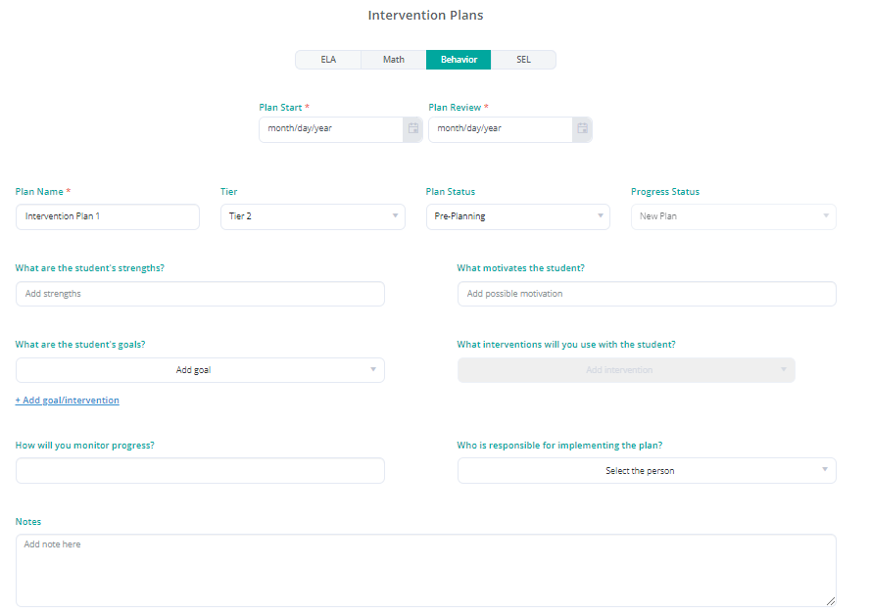
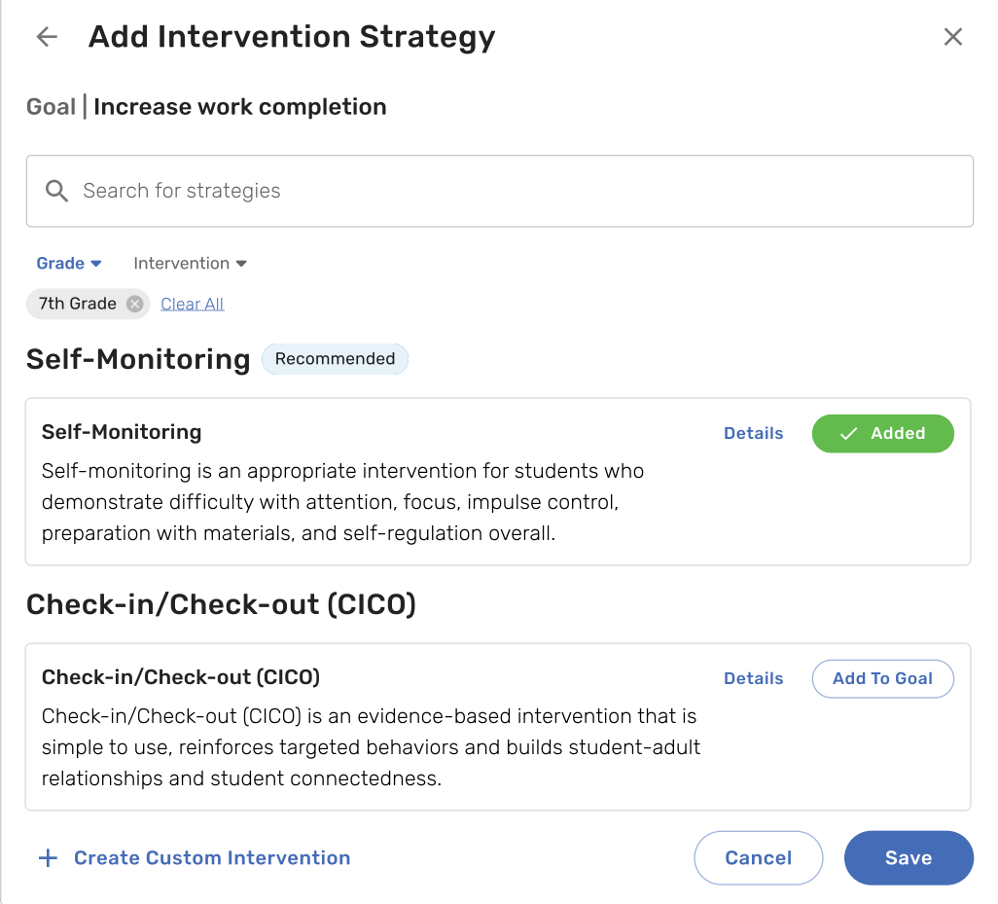
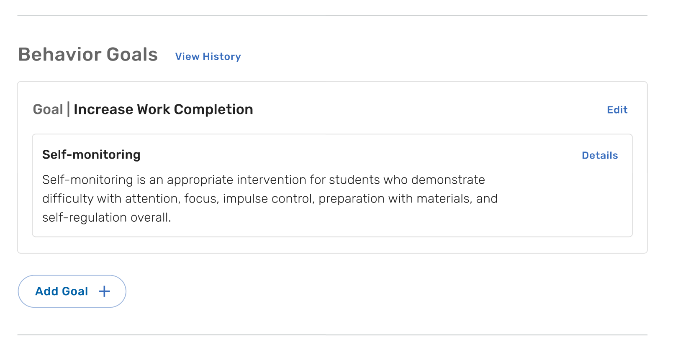
Targeted, Guided Intervention Planning - Behavior
✔ Guided plan creation for
supporting positive student behaviors.
✔ Provides suggested goals.
✔ Directly connected to evidence-based interventions to meet goals.
✔ The selected goal and strategy can be easily accessed in the student's intervention plan.
Notes:
ERIN:
What this may look like to have a housing system of support.
Guided plan creation with goal banks corresponding with evidence-based interventions and implementation resources embedded as grab and goes

Slide 40
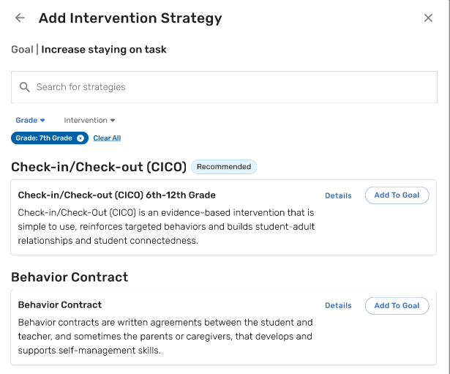
Intervention Library Access
✔ Differentiated based on the needs of each learner
✔ Automatic recommendations to make planning easy
✔ Research-based interventions with 100s of strategy cards, activities and resources
Notes:
ERIN:
When selecting a goal for this behavior intervention plan, a list of goals appropriate for that student’s needs populate.
Upon choosing the goal”, a list of interventions specific to that goal and the student’s grade level are automatically recommended.
Each intervention will have a variety of Strategy Cards that educators can choose and connect to the student’s intervention plan.

Slide 41
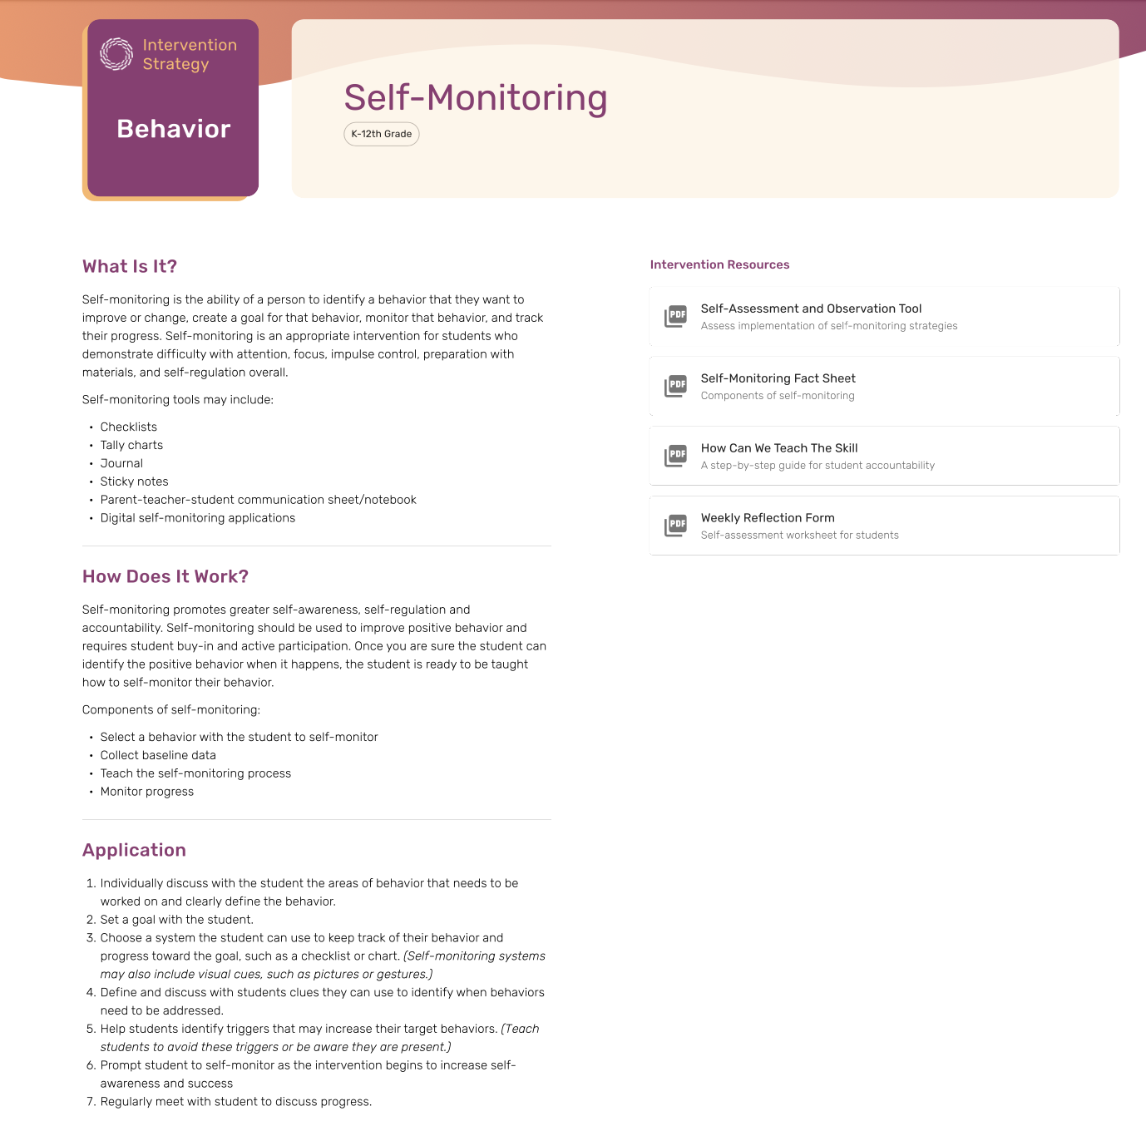
Intervention Strategy Card - Behavior
✔ Goal: Increase work completion or staying on task.
✔ Intervention: Self-Monitoring
✔Resources: A series of resources are available to support self-monitoring for all three tiers across all grade-levels.
Notes:
ERIN
Intervention Strategy example

Slide 42
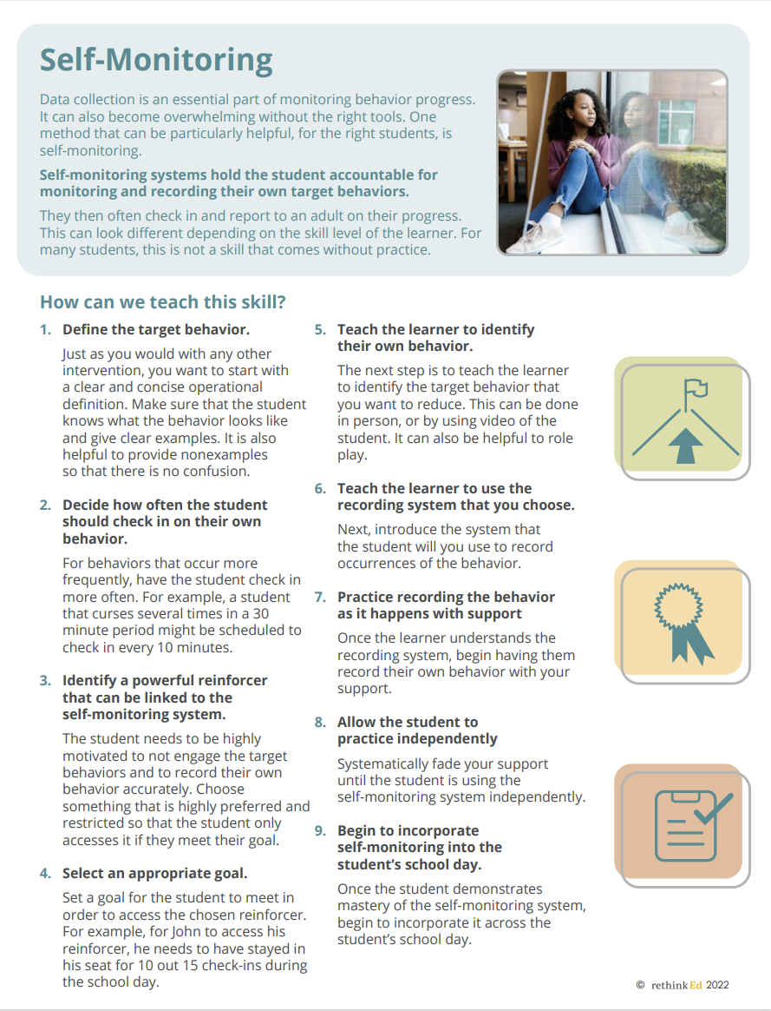
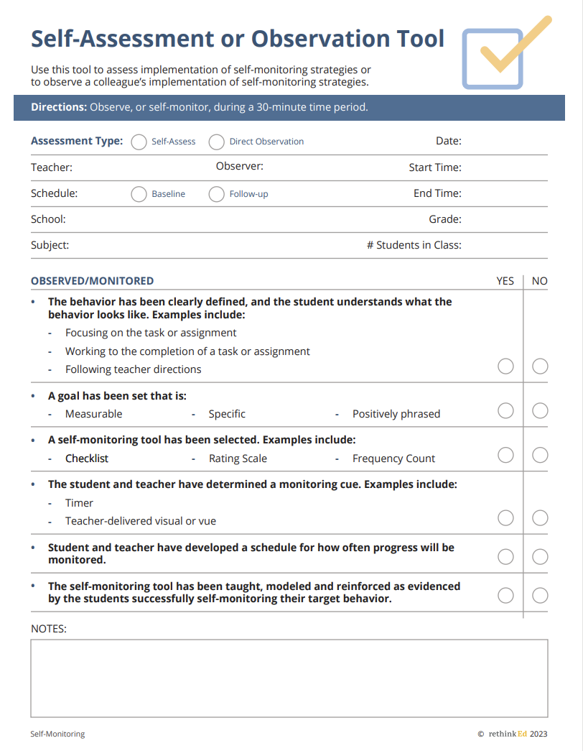
Intervention Strategy Resources - Behavior
Resources: Self-Monitoring Guide for educators and observation tool for students.
Notes:
ERIN:

Slide 43
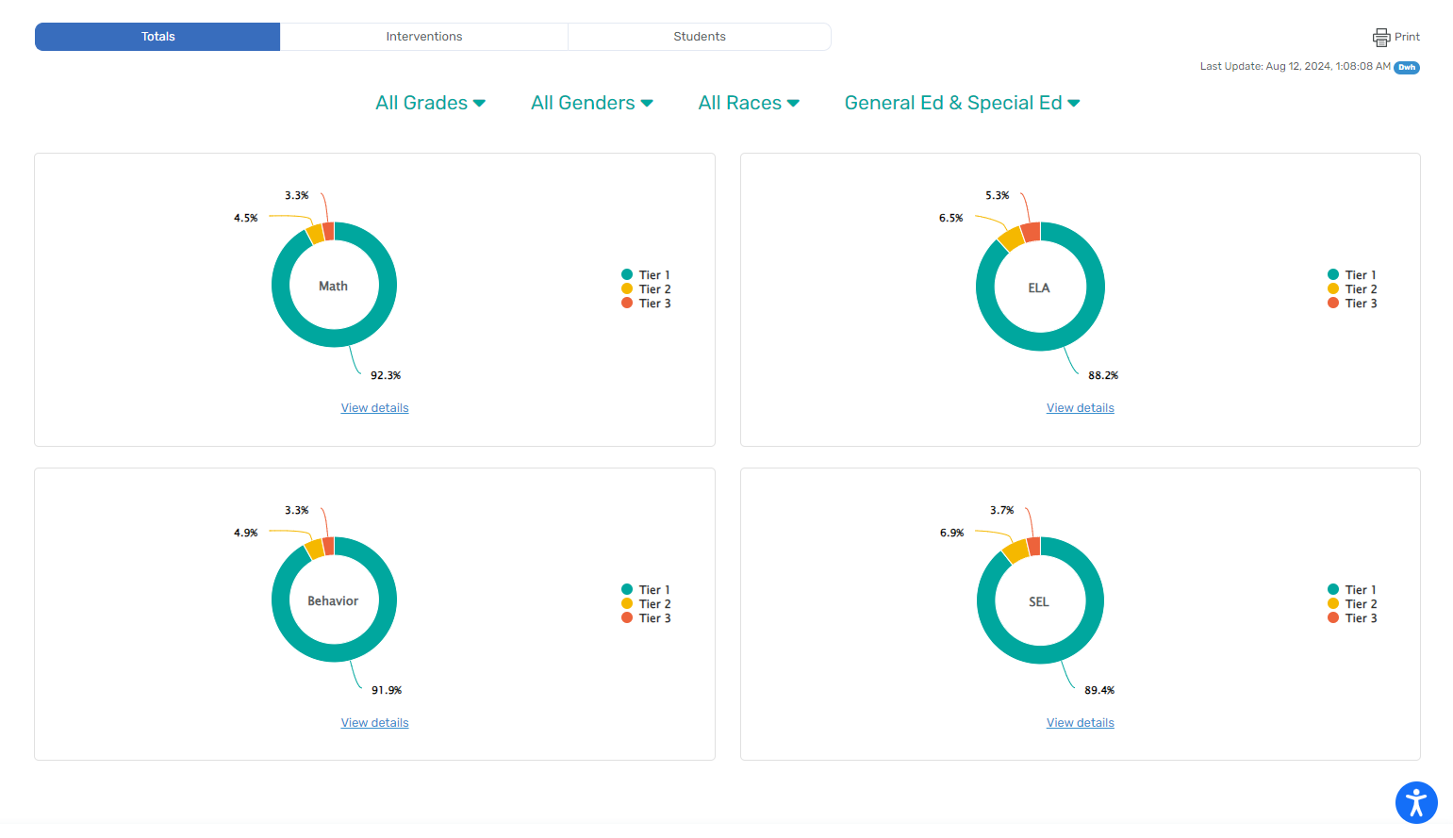
Admin Fidelity of Intervention Dashboard
Notes:
ERIN:
Administrators can view the # of students at each behavior tier, based on grade and demographic information
Behavior Tiers
Can be calculated based on incidents recorded through Rethink tools or other tools used within the district
Identify students who may be in need of additional support
Ensure all plans are up to date
Data can be viewed by individual student or at the classroom, building, region or district level to effectively evaluate trends. All data can be exported directly from the platform or can be sent to the districts data housing team for custom analysis.

Slide 44
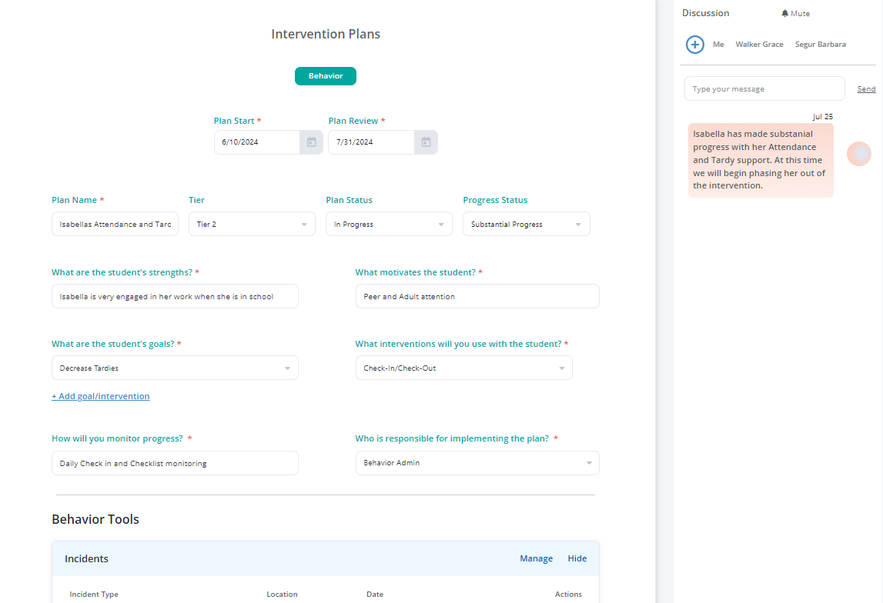
Intervention Plan Review and Discussion
Notes:
Intervention Plan Review and Discussion
Utilize collaborate with colleagues to make sure all members of the instructional team are in agreement
Plan dates and progress monitoring checkpoints established.

Slide 45
What Type of Behavior Support Optimizes Learning and Instructional Engagement?
√ Exceptional Educator Training builds sustainable capacity system-wide
X Teacher Training Gaps
X Multiple Platforms & Processes
X Inefficient Intervention Planning Processes
X Limited Tracking Tools
√ All-in-One Behavior Platforms integrated data, intervention planning & tracking
to support the whole child
√ Intuitive Tools unify planning and progress monitoring to promote collaboration
√ Automated Reporting monitor intervention effectiveness to drive
continuous improvement
Results? Increase instructional time & improve academic performance
Notes:
TRACEY:
IN CLOSING:
We need a variety of things (probability equation) we can do to change a student’s behavior. What is that variety that promotes the highest probability or highest effect size?
Turnkey Classroom Management Training Platforms: Builds system-side capacity using effective instruction practices and decisions. It means there is collective ownership with high expectations of staff to receive continuous adaptable PD by meeting the educator where they are and based on what they need. It means consistent review and adaptations made to PD based on data. It means there are PD plans in place for ALL staff, families, caregivers, community.
Platform and Tools: Streamline platform that will use behavior tools and intervention planning and the data from those tools and interventions to inform and make effective decisions. The platform houses Pd needs of all staff as well as strategy and intervention tools that are most effective so they continue to include them in their repertoire and build upon.
Reporting: Again how effective is this and how do I know? I have a robust system telling me how everything is going and everyone in my district uses this robust system.

Slide 46

www.RethinkEd.com

